Slide 1
Unreal Engine 5 Basics

Slide 2

Tool Bar
(From left to right)
The arrow is to use the regular arrow to move around the map
The cross is used to move objects up, down, towards you and away from you.
The circle with two arrows is used to rotate an object.
The arrow pointing to a corner is to scale objects.
The cube in the corner cycles the transform gizmo coordinate between world and local objects.
The 3 arrow pointing outwards is to control how an object snaps to the surface.
The grid is for where an object's snaps and you can adjust it with the number to the right. To remove snap you would simply click the 3 arrow icon.
The dot and the arrow disables and enables snapping objects the grid scale and this can be adjusted with the number to the right of the icon.
The next icon is for the camera speed.
The four box grid is for the viewport.

Slide 3
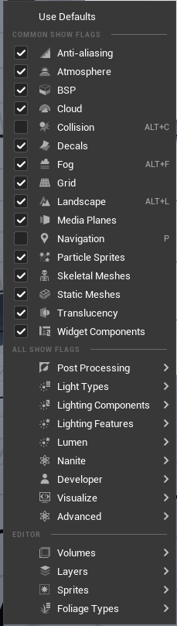
Show Mode
With these options you can hide and and show items. Everything that is checked being shown.

Slide 4
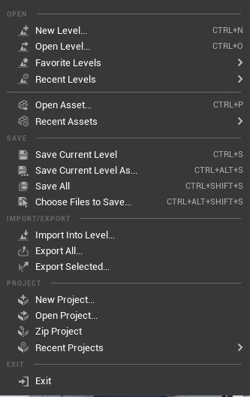
File Menu
To create a new level you can click new level or open level.
This is where you would save all your work or click the save icon.

Slide 5
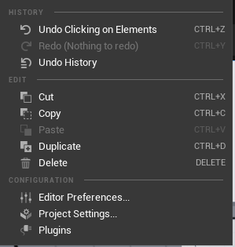
Edit menu
Here you can:
Undo and redo actions that was done,
Cut, paste, copy delete and duplicate.
This is also a good place to edit your preferences and to remove and add plugins.

Slide 6
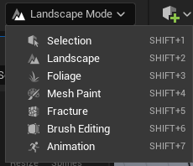
Landscape Modes
Here is the different modes you can select from. Here you can edit the VR world adding different textures, landscapes, and colors.
In landscape mode you can create mountains or hills and you can sculpt the landscape as well.
Then foliage mode allows you to paint objects like rocks, trees, grass, and etc onto your landscape.
Mesh mode allows you to paint directly onto a mesh, in this mode you can really customize a look.
Modeling mode is a new mode added into Unreal Engine 5 where you can 3D model objects.
Fracture mode allows you to create destructible meshes. For instance if you wanted to make a sphere explode you would go into factory mode and put the fracture into the sphere.
Brush editing allows you to create very basic brushes and geometry and this can be useful for leveling out blocks.
Animation mode is where you can create custom animations for character or for cinematics inside of the engine.

Slide 7
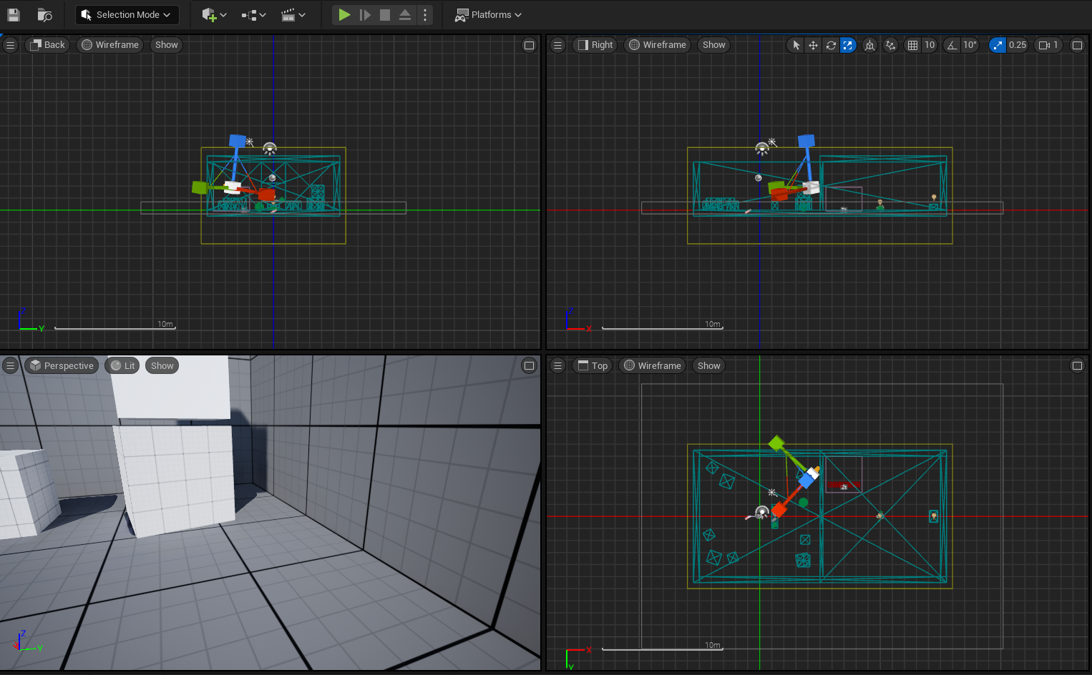
The Viewport
With the view port you can see different views of the world you can working on. In this instance it would be the wireframe.
To change the from the wire frameview you must click the Lit button to choose a different mode. This would be on the right side of the Perspective button.

Slide 8
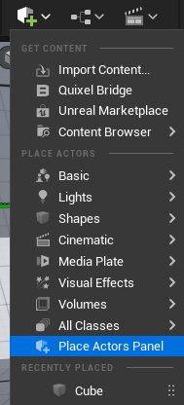
Cube dropdown menu
Get Content:
Import Content is where you can important content from your computer
Quixel Bridge is a library of high quality 3D assets.
Unreal Engine Marketplace is is from the Epic Games launcher and you can important things that you have bought from the marketplace.
Place Actors:
Here you can simply drag and drop any of the actors onto your environment.
However a good short cut is if you click All Classes you can easily search whatever you need.

Slide 9
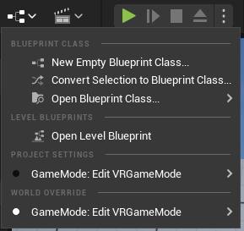
Blueprint Drop down
Here at the Blueprint drop down you can:
Create new blueprints from scratch
Open made blueprints
Convert Selection to Blueprint Class: If you have an existing object or actor selected in your scene, this option lets you convert it into a Blueprint class. This is useful for adding functionality to an object without having to start from scratch.
Open Blueprint Class opens a dialogue to let you browse and open an existing Blueprint class. You can then edit the Blueprint using the visual scripting editor.
GameMode: Edit VRGameMode: there are options that allows editing a specific game mode. Game modes in Unreal Engine define the rules of the game, likewhat players can do, what constitutes winning or losing, and so on.

Slide 10
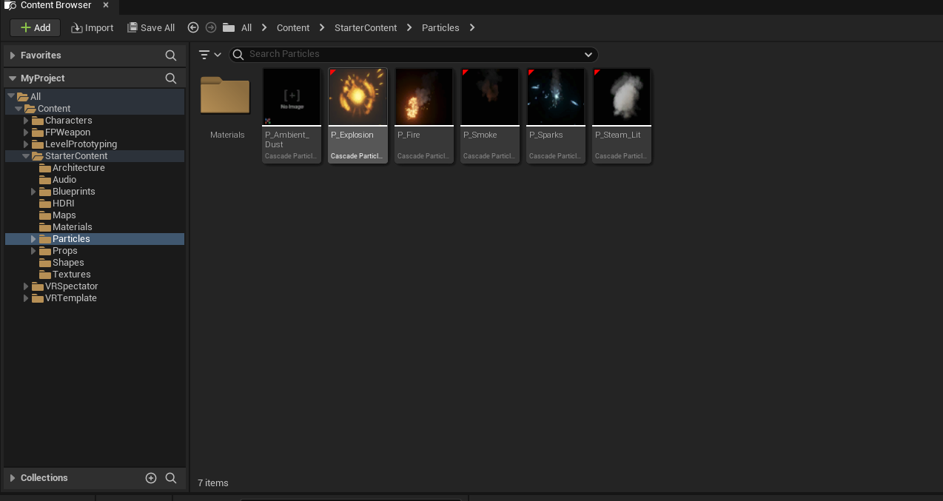
Content Drawer
The content drawer is where everything in your world lives and all the items that you may have imported into Unreal Engine 5.

Slide 11
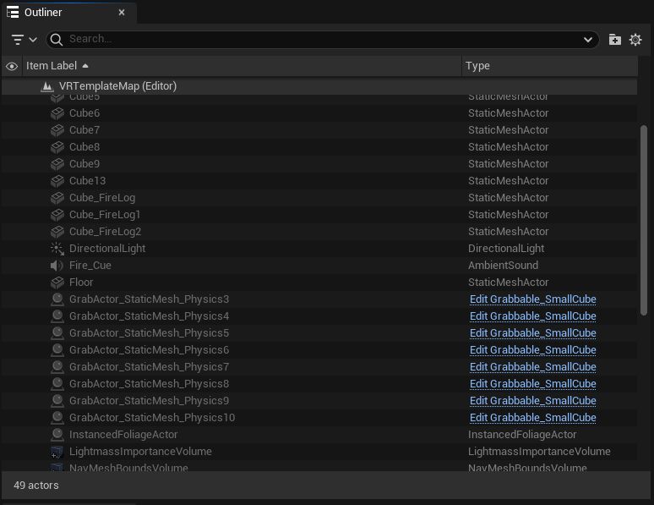
Outliner
The outliner shows everything that is placed in your world and on your level. Here you can edit blueprints of each object and you can click on one of the options to show where it is in your world.

